Slide 1
RANDOM

Slide 2
PROBLEM STATEMENT
OWNING LUXURIOUS PRODUCTS IS NOT FOR EVERYONE......

Slide 3

SOLUTION

Slide 4
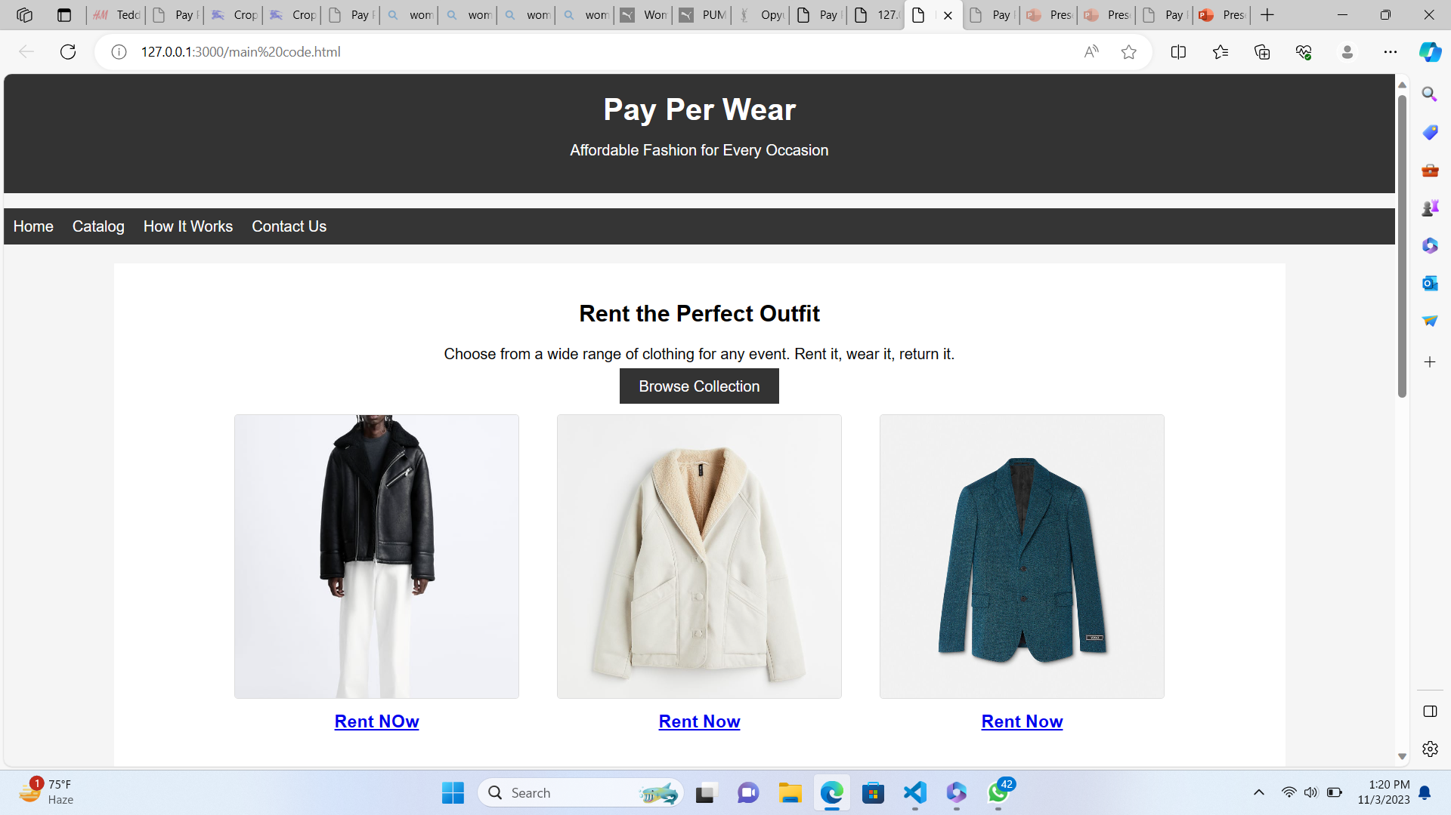
SO SOLUTION FOR THIS PROBLEM IS OUR ONLINE BASED WEBSITE WHICH IS DONE USING HTML AND CSS...
COMING TO OUR MAIN MOTIVE OUR WEBSITE IS A PLATFORM WHERE OUR CUSTOMER DECIDES TO ORDER OR RENT AN FASHION BASED ACCESSORY...
WE BASICALLY RENT ANY KIND OF FASHION ACCESSORY WITH THE MOTIVE OF MAKING EVERYTHING AVAILABLE FOR EVERYONE................

Slide 5
METHODOLOGY
STEP 1 :- CUSTOMERS ORDERS THROUGH OUR WEBSITE.
STEP 2 :- HE ORDERS A PARTICULAR ITEM.
STEP 3 :- THEN THE WAREHOUSE SITUATED WILL RECEIVE THE ORDER.
STEP 4:- THEN THE FOLLOWING PRODUCT IS SENT FOR SHIPPING.
STEP 5:- OUR DELIVERY GUY WILL DELIVER THE PRODUCT AT HIS DOOR.
STEP 6:- AFTER A FEW DAYS OR SO THE CUSTOMER RETURNS THE PRODUCT AND A DELIVERY GUY WILL COLLECT IT AND SEND IT TO LAUNDRY.
STEP 6:- AFTER LAUNDRY THE PRODUCT IS DELIVERED BACK TO WAREHOUSE AND UNTIL NEXT TIME.

Slide 6
CUSTOMER

Slide 7
RENT IT

Slide 8
WAREHOUSE

Slide 9
DOOR TO DOOR DELIVERY

Slide 10
DELIVERED TO CUSTOMER

Slide 11
CUSTOMER RETURNS THE PRODUCT

Slide 12
LAUNDRY TO WAREHOUSE

Slide 13
GITHUB LINK
Rent-It./ at main · GundaAkhil123/Rent-It. (github.com)

